Slide 1
COLOR BLOCK
assistive app for the colorblind

Slide 2
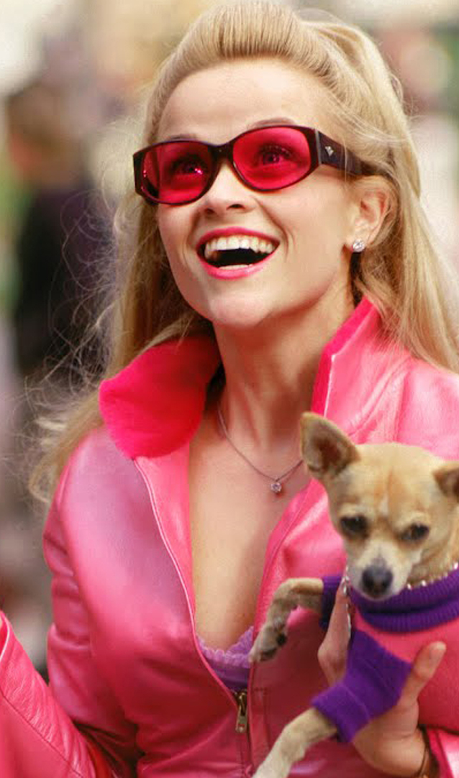
LEGALLY BLIND
Color blindness affects 8 ~ 10 % of the population
Multiple types exist, most are mild
If you've never seen color, how can you tell you have a problem with colors?
Insecurities

Slide 3
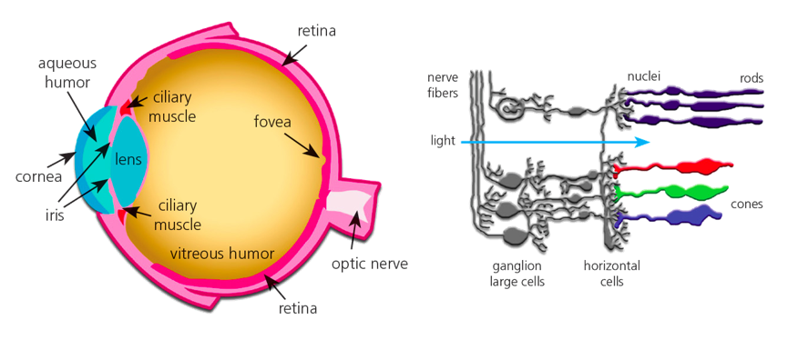
Perception to Everything

Slide 4
“FORGET COLORS”
Subject to ridicule
Reading maps and graphs
Identifying traffic lights and signs
Judging food
Can't dress or wear makeup properly !

Slide 5

SIRI, HELP !
Mobile APP
Allows for seeing color
Science-based !

Slide 6
Applications ?

Slide 7
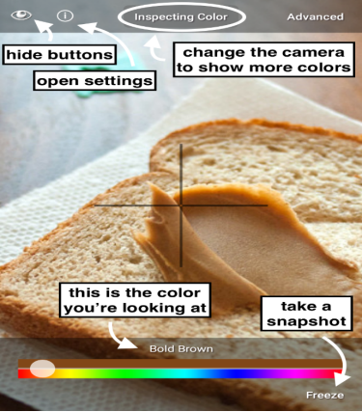
Color Blind Pal
Easy usage of common color names
Freeze and inspect
Use the phone as a portal

Slide 8
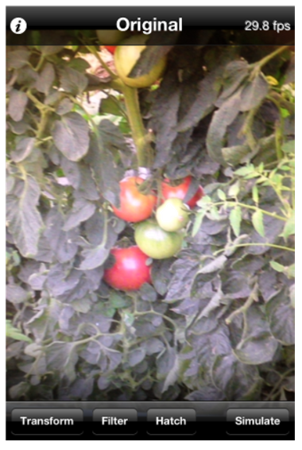
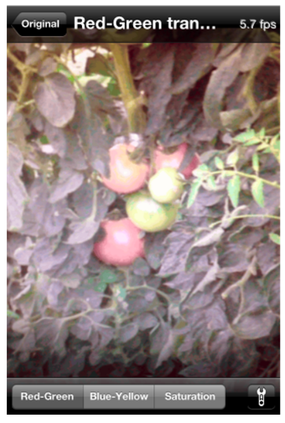
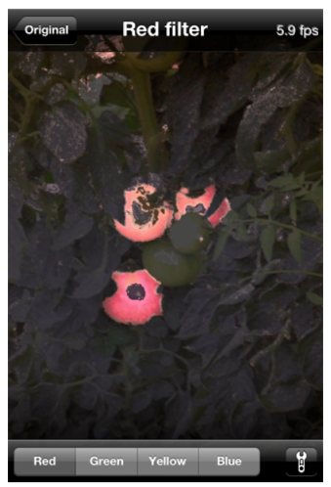
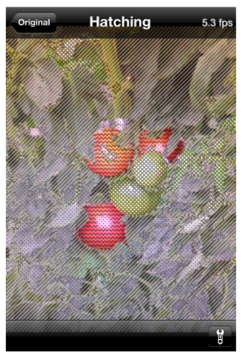
Visolve App
brighter transformations

Slide 9
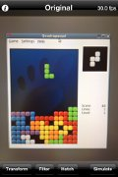
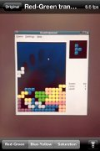
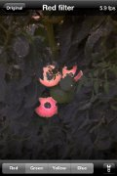
Red-Greeen transform
brightter reds // darker greens
Blue-Yellow transform
brighter blues // darker yellows
Filtering
darkerns all but the specified colors
Hatching
drawing hatch patterns depending on colors
Saturation increase

Slide 10
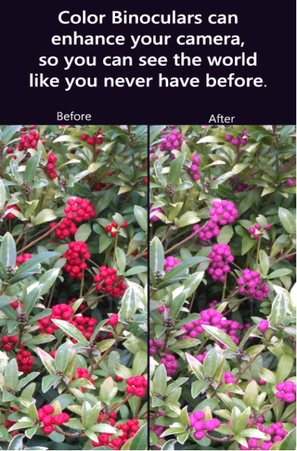
Color Binoculars
Distinguish colors in everyday lives
Replacing difficult color combinations
Supports all types of color blindness

Slide 11
Our Approach

Slide 12
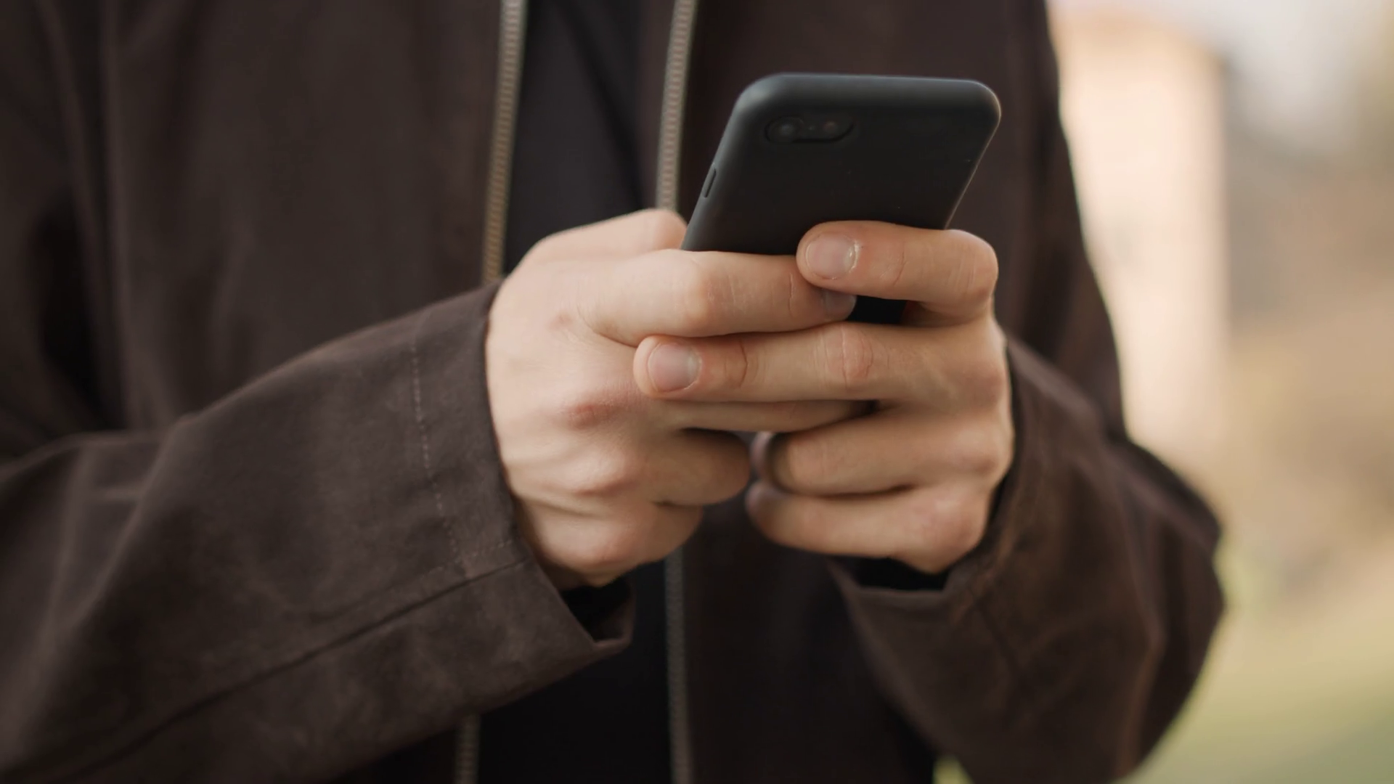
HOW TO USE ?
Upload the images of clothing items
The app determines if the colors are a good match

Slide 13
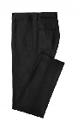
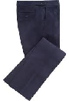
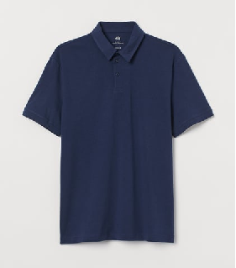
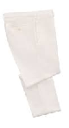
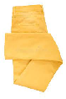
Our Application
matching ?

Slide 14
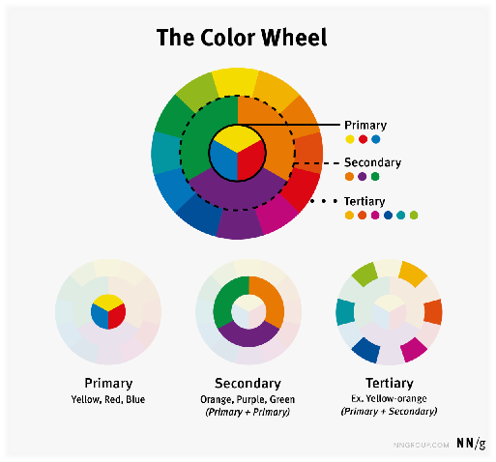
Color
Groups

Slide 15
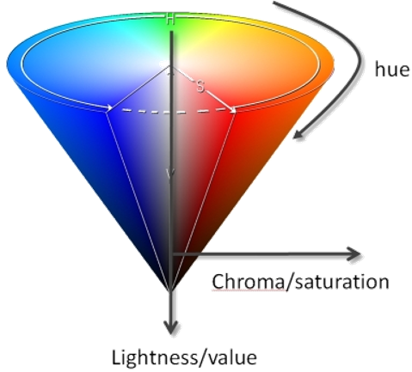
Color Characteristics
Hue : The appearance of color itself –blue
Saturation : Purity of Color
Lighting : Brightness of Color

Slide 16
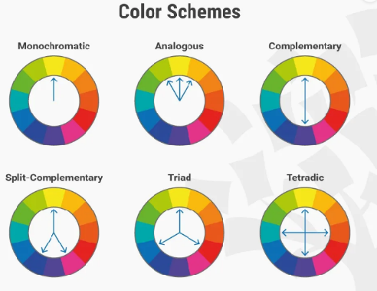
Color
Theory
Do the colors go along ?

Slide 17
HOW TO IMPLEMENT ?
Read image then convert to HSV
Color detection for object / clothing item
4
Color-matching based on HUE angles and color theory
2
Object detection for clothing item
3
1

Slide 18
APP DEMO

Slide 19
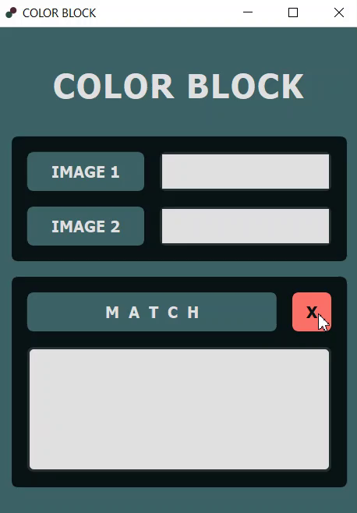

Slide 20
THANK YOU
team 19

